Slide 1
Classification-Based Predictive Analysis of Loan Default
Esteban Gomez
01/17/2024

Slide 2
Introduction
Effective risk management in lending identifies potential lender losses and significantly impacts consumer credit scores.
The project aims to evaluate classification algorithms for predicting defaults on unsecured loans using LendingClub data.
The methodology uses Python libraries and machine learning models to predict loan defaults, with documentation in Jupyter Notebooks for business workflow integration.
Numpy | Pandas | Matplotlib | Seaborn | Sci-kit Learn

Slide 3
Exploratory Data Analysis
LendingClub's dataset contains over 38,000 entries and minimal missing data. The final model was built using 20 of the initial 36 columns.
Defaulted loans constitute only 15% of the data, posing a challenge of class imbalance that needs to be addressed for effective model performance.
Data exploration revealed weak correlations between features and loan default status, challenging decisive classification.

Slide 4
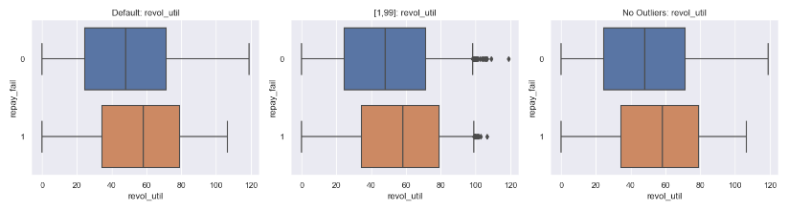
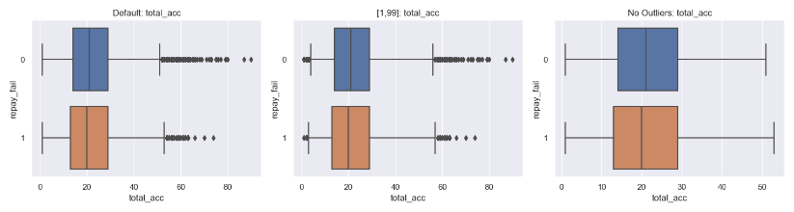
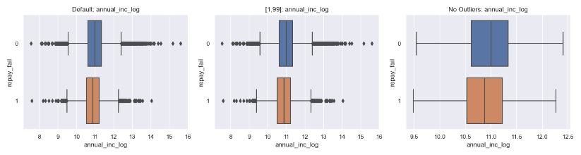
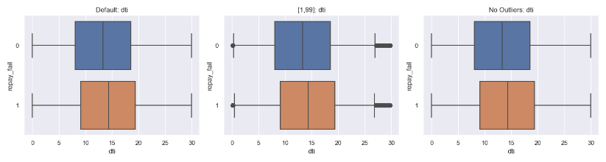
Exploratory Data Analysis
Visual analysis with boxplots in Figure 1 highlights the small distribution differences among numerical features per class of loan, with varying outlier limits to enhance understanding of skewed data.
Figure 1. Numerical Distributions of defaulted and non-defaulted loans.

Slide 5
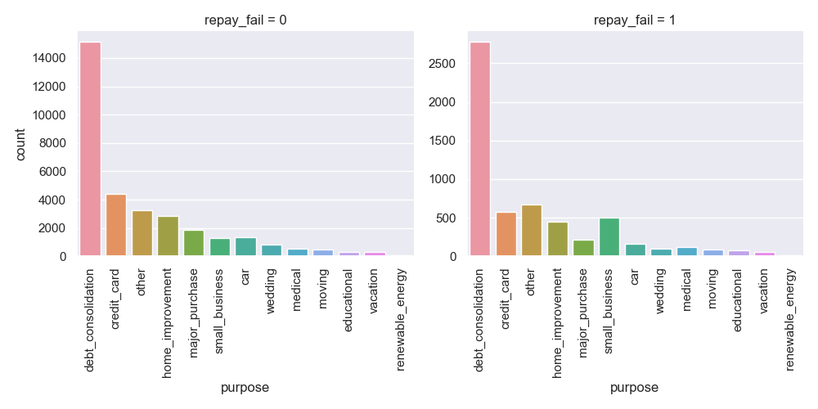
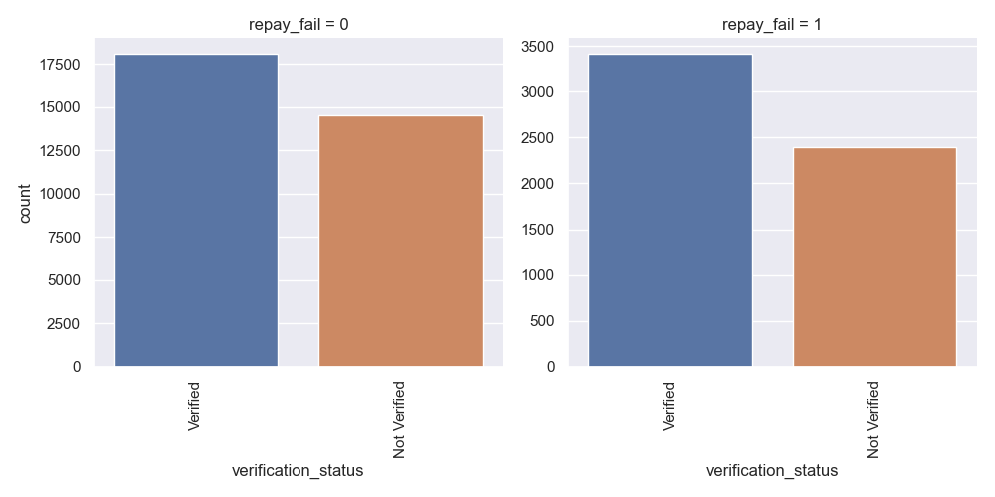
Exploratory Data Analysis
Categorical features follow the same pattern where the differences could be more apparent for the model to decipher clear patterns.
Figure 2. Categorical distributions of defaulted and non-defaulted loans.

Slide 6
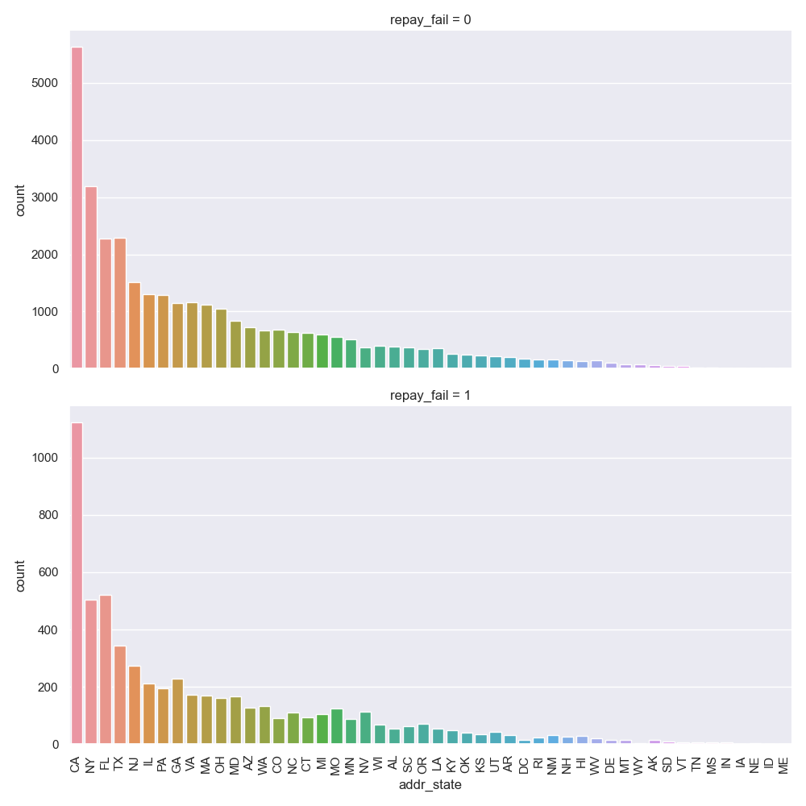
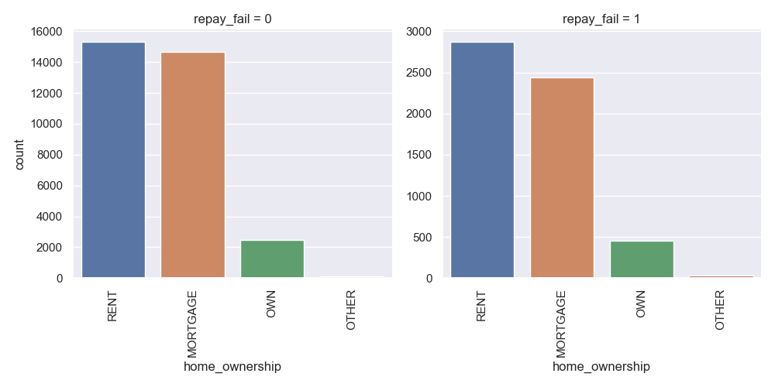
Exploratory Data Analysis
Figure 4. Categorical distributions of defaulted and non-defaulted loans.

Slide 7
Modeling – Data Pre-Processing
The initial model setup involved preparing the data with dummy variables for categorical features and splitting it into training and test sets.
The first training phase focused on identifying the most effective models, using LazyClassifier to provide a preliminary comparison of various models.
Model | Accuracy | F1 Score
XGBClassifier | 84.20% | 78.99%
BernoulliNB | 84.10% | 78.93%
LinearDiscriminantAnalysis | 84.88% | 78.75%
Table 1. LazyClassifier accuracy and F1 score results are sorted by F1 score and then accuracy.

Slide 8
Modeling – Initial Fits
It is evident that the models struggle to identify any defaulted loans, leading us to tackle the class imbalance.
Model | Class | Precision | Recall | F1 Score | ROC AUC
XGBClassifier | Non-defaulted | 85.38% | 98.21% | 91.35% | 67.73%
 | Defaulted | 35.68% | 5.58% | 9.65%
BernoulliNB | Non-defaulted | 84.88%% | 100% | 91.82% | 60.13%
 | Defaulted | 0% | 0% | 0%
LinearDiscriminantAnalysis | Non-defaulted | 85.20% | 99.47% | 91.78% | 70.91%
 | Defaulted | 50% | 2.96% | 5.60%
Table 2. Model results from the initial fit of training data.

Slide 9
Modeling – Oversampling
A subset of the data is created by resampling the minority class (defaulted loans) with replacement until there is an equal number of loans in the subgroup to the number of non-defaulted loans.
Model | Class | Precision | Recall | F1 Score | ROC AUC
XGBClassifier | Non-defaulted | 97.22% | 82.11% | 89.03% | 92.11%
 | Defaulted | 46.36% | 86.78% | 60.43%
BernoulliNB | Non-defaulted | 88.47% | 56.38% | 68.87% | 60.42%
 | Defaulted | 19.35% | 58.75% | 29.11%
LinearDiscriminantAnalysis | Non-defaulted | 91.14% | 65.21% | 76.02% | 71.03%
 | Defaulted | 24.79% | 64.39% | 35.80%
Table 3. Model results after fitting the oversampled data.

Slide 10
Modeling – Cross-Validation
We tuned the hyperparameters for each model and compare the results to determine which model to focus on optimizing.
Model | Class | Precision | Recall | F1 Score | ROC AUC
XGBClassifier | Non-defaulted | 96.50% | 79.42% | 87.13% | 90.17%
 | Defaulted | 42.04% | 83.82% | 55.99%
BernoulliNB | Non-defaulted | 88.45% | 56.46% | 68.93% | 60.39%
 | Defaulted | 19.34% | 58.61% | 29.08%
LinearDiscriminantAnalysis | Non-defaulted | 91.21% | 65.28% | 76.10% | 71.03%
 | Defaulted | 24.91% | 64.67% | 35.97%
Table 4. Model results after cross-validation and fitting the oversampled data.

Slide 11
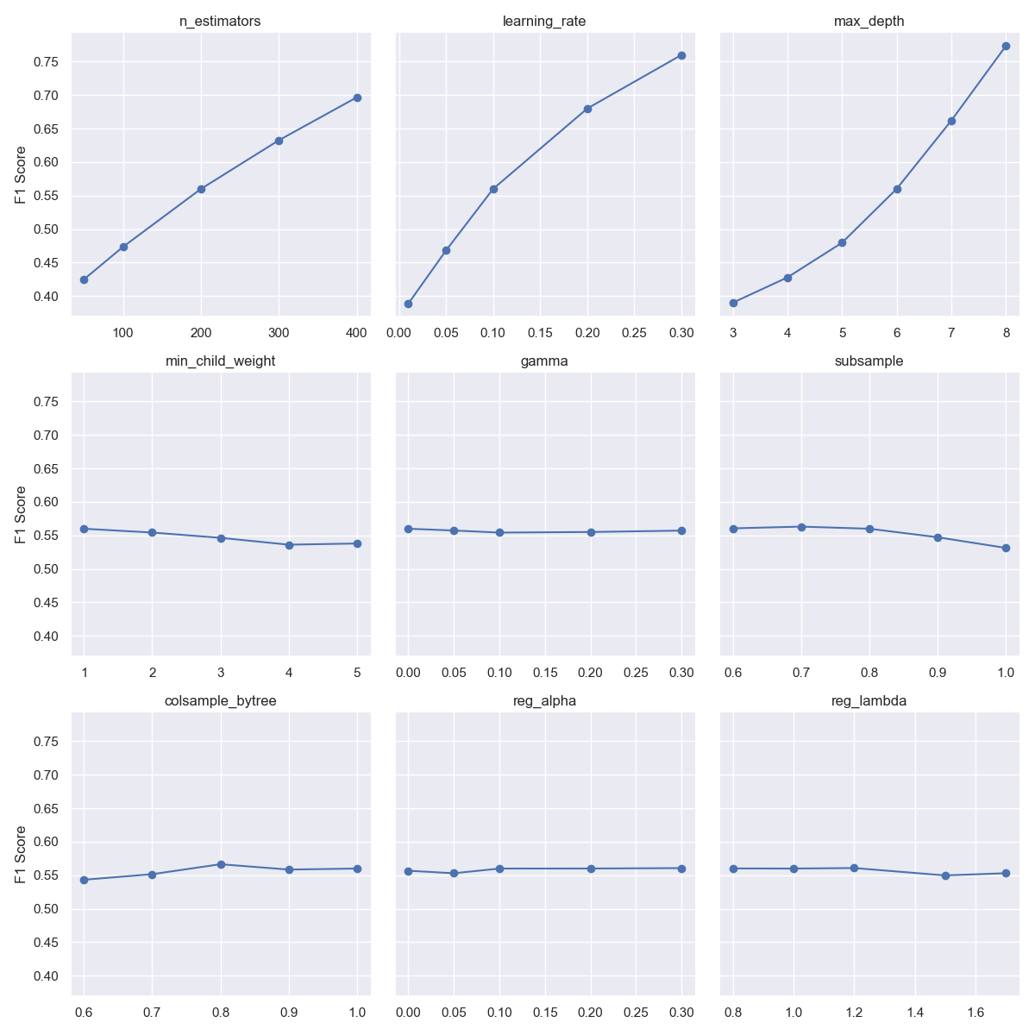
Optimizing XGBClassifier
Modeling –
To improve the model, we want to expand the hyperparameter grid, which comes at a higher computational cost.
We test hyperparameters and their individual impact on the F1 score.
The most impactful hyperparameters are learning_rate, max_depth, and n_estimators.
Figure 4. F1 score at different hyperparameter values.

Slide 12
Modeling – Optimizing XGBClassifier
The results indicate that the model is likely overfitting the data since the scores are remarkably high.
Model | Class | Precision | Recall | F1 Score | ROC AUC
XGBClassifier | Non-defaulted | 99.85% | 97.69% | 98.76% | 99.62%
 | Defaulted | 88.45% | 99.17% | 93.51%
Table 5. Results after performing cross-validation with the three significant hyperparameters.

Slide 13
Modeling – Test on Unseen Data
We introduce an unseen dataset and make predictions to determine whether the model is overfitting the data.
Feature mismatches led to retraining the model excluding non-imputable features.
Model | Class | Precision | Recall | F1 Score | ROC AUC
XGBClassifier | Non-defaulted | 99.85% | 97.47% | 98.65% | 99.47%
 | Defaulted | 87.48% | 99.17% | 92.96%
Table 6. Results after the removal of non-imputable features.

Slide 14
Modeling – Test on Unseen Data
The model predicts that most loans in the unseen dataset will not default, confirming its inability to generalize.
Model | Class | Precision | Recall | F1 Score | ROC AUC
XGBClassifier | Non-defaulted | 88.45% | 95.25% | 91.72% | 52.03%
 | Defaulted | 12.90% | 5.36% | 7.57%
Table 7. Results from making predictions on the unseen data.

Slide 15
Modeling – Re-train with Unseen Data
We integrate some unseen data into training the model to construct a more robust model.
We under-sampled the unseen data and then split it in half. One-half is consolidated with the original dataset for training, and the other half is saved for testing.
Model | Class | Precision | Recall | F1 Score | ROC AUC
XGBClassifier | Non-defaulted | 84.84% | 79.00% | 81.82% | 91.39%
 | Defaulted | 80.18% | 85.75% | 82.87%
Table 8. Results from the model trained with consolidated data.

Slide 16
Modeling – Re-train with Unseen Data
The model predicts that most loans in the unseen dataset will not default, confirming its inability to generalize.
Model | Class | Precision | Recall | F1 Score | ROC AUC
XGBClassifier | Non-defaulted | 84.84% | 79.00% | 81.82% | 91.39%
 | Defaulted | 80.18% | 85.75% | 82.87%
Table 8. Results from the model trained with consolidated data.

Slide 17
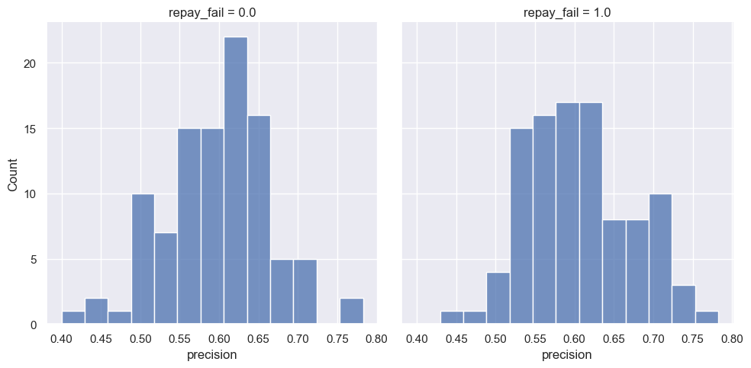
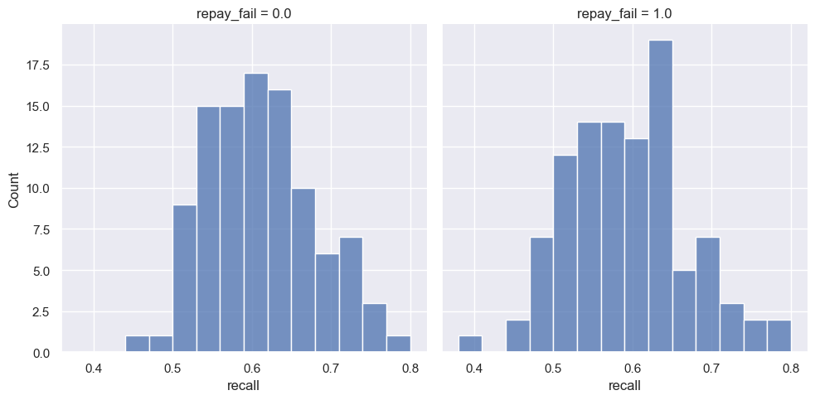
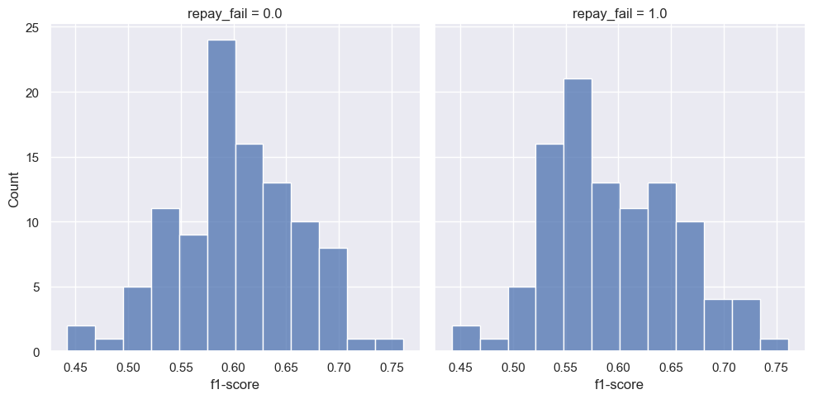
Modeling – Re-train with Unseen Data
To simulate how the model will perform in a real-world application, we feed it samples of 100 loans at a time and record its results.
This process is a simulation of 100 loan applications being submitted at a time, and the model predicts which loans of those 100 will default.
Figure 5. Distribution of results on unseen test data by samples of 100 loans.

Slide 18
Modeling – Re-train with Unseen Data
Table 9 suggests the model is still overfitted to the original dataset.
As we noticed in the distributions, the model’s performance averages around 60% for all the scores on the unseen test data.
Model | Class | Precision | Recall | F1 Score | ROC AUC
XGBClassifier (Original Test Data) | Non-defaulted | 99.57% | 96.07% | 97.79% | 99.17%
 | Defaulted | 81.59% | 97.66% | 88.90%
XGBClassifier (Unseen Test Data) | Non-defaulted | 60.18% | 61.37% | 60.77% | 64.89%
 | Defaulted | 60.59% | 59.40% | 59.99%
Table 9. Results from the model trained with consolidated data on the original test data and unseen test data.

Slide 19
Discussion
Increased complexity of the model has led to a plateau in improvements, making additional refinements less effective.
Techniques like SMOTE/ADASYN sampling, ensemble methods, and L1/L2 regularization could improve results.

Slide 20
Conclusion
We developed a model to analyze financial profiles and classify an applicant as a potential default.
The model was refined using the unseen dataset, making it a helpful accessory in raising red flags for financial managers.
A class imbalance and weak feature correlations accompany the inherent nature of the problem.

